Slide 1
Purchase Management
(Requirement Analysis)
Team 33 :
Diksha Agarwal
Saloni Singh
Udish Nagpal
Sakshi Srivastava

Slide 2
Problems Faced by Administration
A software is needed to manage all the activities involved in purchase management of an institute as manual work takes a lot of time.
It is difficult to track the status of the indented purchase.
Transparency issue for everyone.

Slide 3
Life cycle of process:
User logs in using his/her credentials.
The indenter can either draft a new indent form or check status of previously
indented form.
Other members can see the pending drafts for verification and approval and can add comments.
If any new indent is drafted then it passes onto HoD of concerned department and processed further for verification by other members and finally to the Director.
Director either approves/rejects the form and send it back to indenter with comments.
If the purchase amount < 25k then indenter directly makes the purchase at its own level and uploads a certificate for the same.
If purchase amount >25k then indendor selects the vendors and review committee shortlist the vendors.
PCC finally selects a vendor from the final list.
Purchase is done and invoice is uploaded.

Slide 4
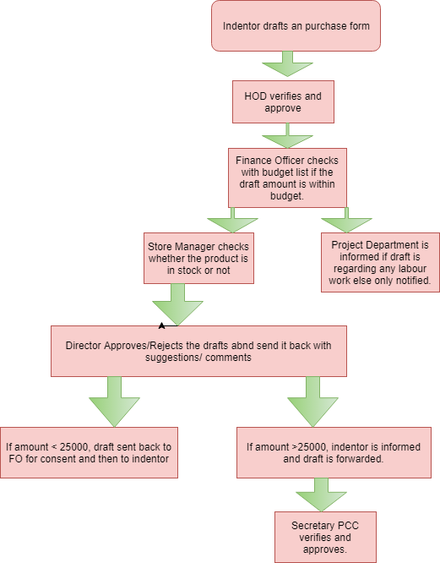
Sequence of Steps for approval :
for an indented form to pass from Indenter to Director and finally get Approved. Otherwise it returns back to previous stage with added suggestions.

Slide 5
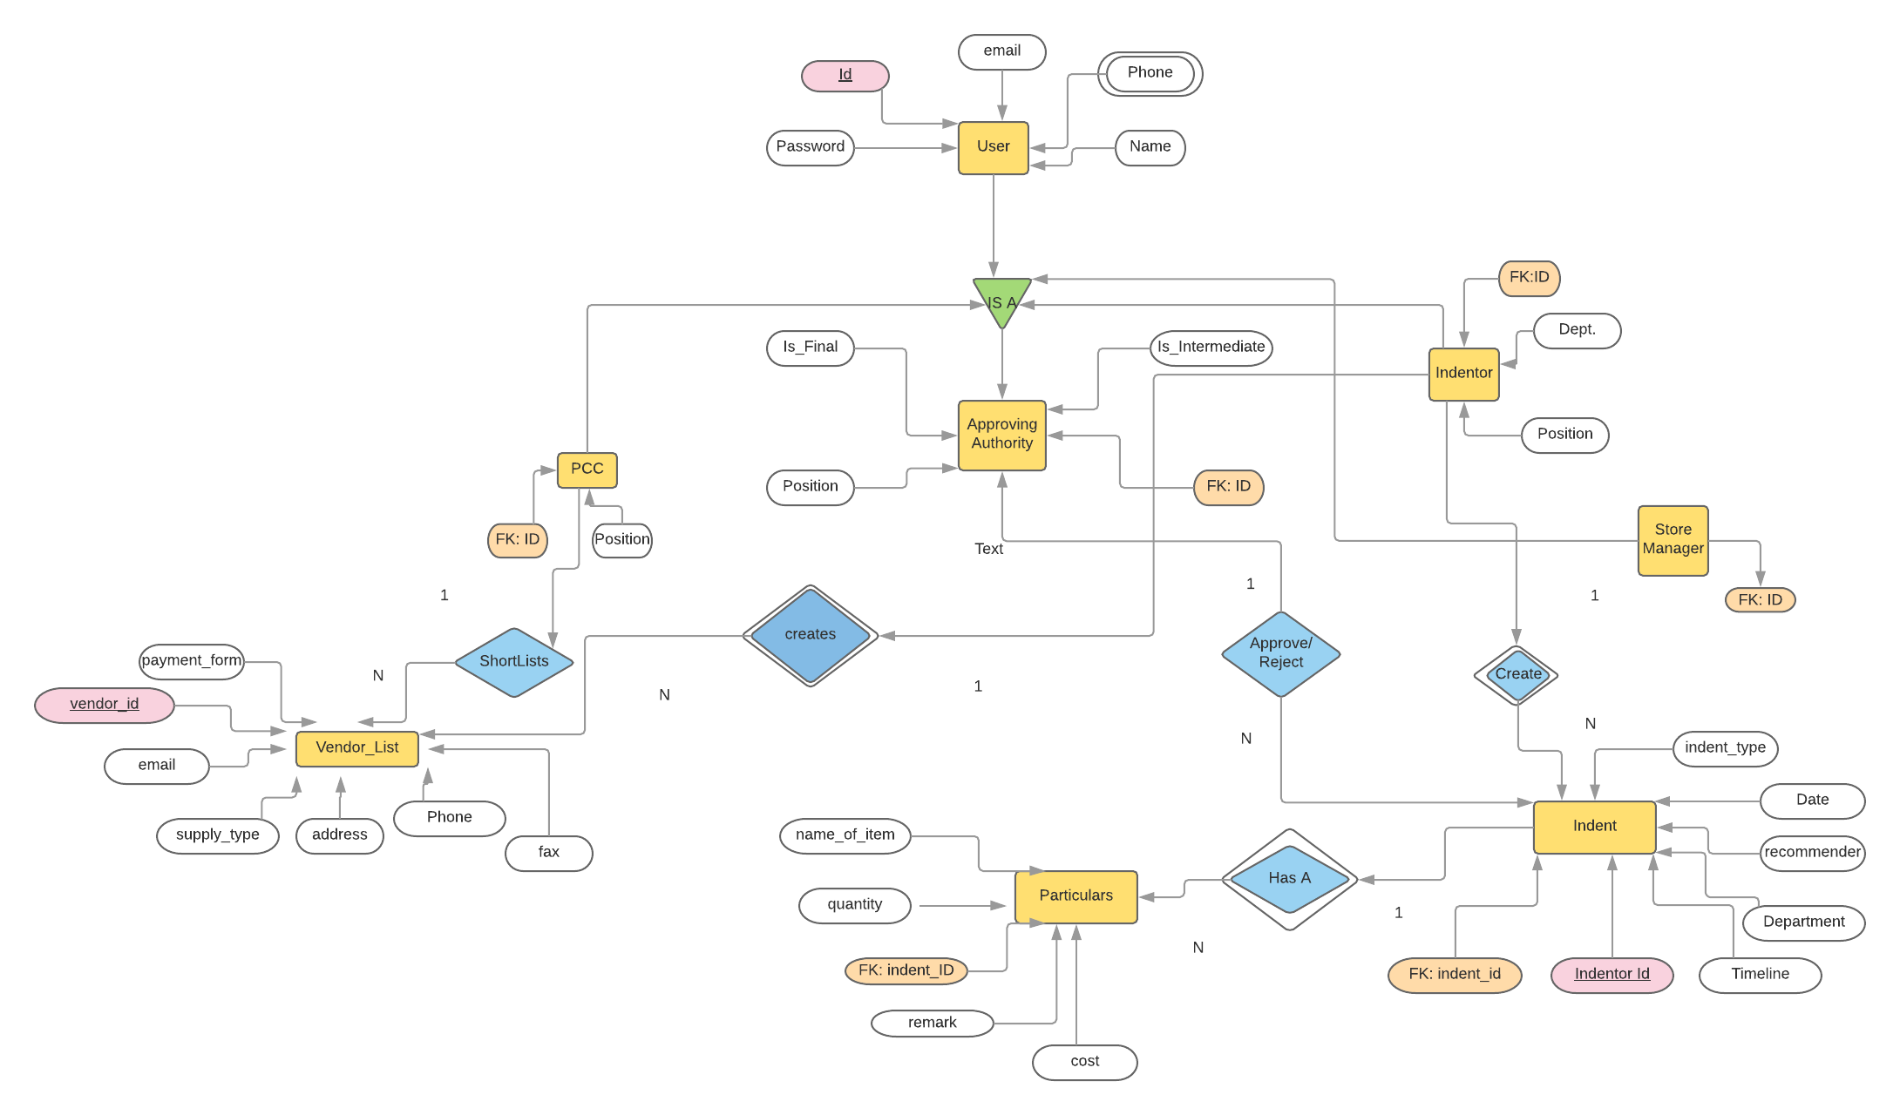
ENTITY RELATIONSHIP DIAGRAM:

Slide 6
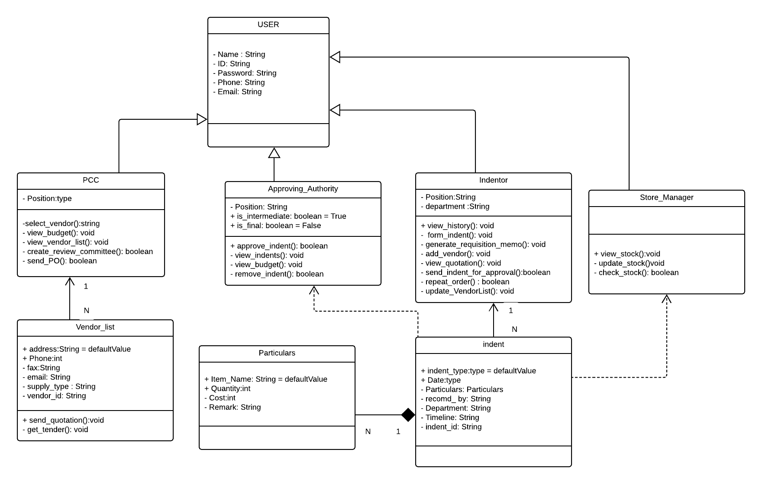
UML CLASS DIAGRAM:

Slide 7
Features
A portal for all staff members and administration. Anyone who can indent a purchase has the unique login credentials.
Allocate fixed budget to each department.
Tracking status of an Indented form and view comments.
selection and shortlisting of vendors
maintain a history of purchases.

Slide 8
Preparation
The Team interacted with the Product Manager of LNMIIT, Mr. Abhijit Galav, Store Manager, Mr. Govind Chandwani.
Data
Purchase Record, Indentation Form, Digital Documents(Tender notice etc.)
People Involved
HoD’s, Finance Manager, Store Manager, Product Manager, Faculty, Student Mentor of Various Clubs, Secretary of Student Gymkhana, DoSA.
GUI – Forms and their functionality to implement various feature
Form for Indenter, Vendor List, Login Portal

Slide 9
THANK YOU !!

